Slide 1
Data Structure and Algorithms In JAVA

Slide 2
What is Data Structure ?
A data structure is defined as a particular way of storing and organizing data in our devices to use the data efficiently and effectively. The main idea behind using data structures is to minimize the time and space complexities. An efficient data structure takes minimum memory space and requires minimum time to execute the data.
What is an Algorithm ?
In computer programming terms, an algorithm is a set of well-defined instructions to solve a particular problem.
For example, An algorithm to add two numbers:
Take two number inputs
Add numbers using the + operator
Display the result
Qualities of a Good Algorithm :
Input and output should be defined precisely.
Each step in the algorithm should be clear and unambiguous.
Algorithms should be most effective among many different ways to solve a problem.
An algorithm shouldn't include computer code. Instead, the algorithm should be written in such a way that it can be used in different programming languages.

Slide 3
Factors - Quality of good Algorithm
Time - To execute a program, the computer system takes some amount of time. The lesser is the time required, the better is the algorithm.
Memory - To execute a program, computer system takes some amount of memory storage. The lesser is the memory required, the better is the algorithm.
Accuracy - Multiple algorithms may provide suitable or correct solutions to a given problem, some of these may provide more accurate results than others, such algorithms may be suitable.
Sequence - The procedure of an algorithm must form in a sequence and some of the instruction of an algorithm may be repeated in number of times of until a particular condition is met.
Generality - The designed algorithm must solve isolated problem and more often algorithms are designed to handle a range of input data to meet this criteria, so the algorithms must be generalized.

Slide 4
Types of Algorithms
Brute Force Algorithm: A straightforward approach that exhaustively tries all possible solutions, suitable for small problem instances but may become impractical for larger ones due to its high time complexity.
Recursive Algorithm: A method that breaks a problem into smaller, similar subproblems and repeatedly applies itself to solve them until reaching a base case, making it effective for tasks with recursive structures.
Encryption Algorithm: Utilized to transform data into a secure, unreadable form using cryptographic techniques, ensuring confidentiality and privacy in digital communications and transactions.
Backtracking Algorithm: A trial-and-error technique used to explore potential solutions by undoing choices when they lead to an incorrect outcome, commonly employed in puzzles and optimization problems.
Searching Algorithm: Designed to find a specific target within a dataset, enabling efficient retrieval of information from sorted or unsorted collections.
Sorting Algorithm: Aimed at arranging elements in a specific order, like numerical or alphabetical, to enhance data organization and retrieval.

Slide 5
Types of Algorithms
Hashing Algorithm: Converts data into a fixed-size hash value, enabling rapid data access and retrieval in hash tables, commonly used in databases and password storage.
Divide and Conquer Algorithm: Breaks a complex problem into smaller subproblems, solves them independently, and then combines their solutions to address the original problem effectively.
Greedy Algorithm: Makes locally optimal choices at each step in the hope of finding a global optimum, useful for optimization problems but may not always lead to the best solution.
Dynamic Programming Algorithm: Stores and reuses intermediate results to avoid redundant computations, enhancing the efficiency of solving complex problems.
Randomized Algorithm: Utilizes randomness in its steps to achieve a solution, often used in situations where an approximate or probabilistic answer suffices.

Slide 6
How to measure complexities ?
Time Complexity: Time complexity is used to measure the amount of time required to execute the code.
Space Complexity: Space complexity means the amount of space required to execute successfully the functionalities of the code.
You will also come across the term Auxiliary Space very commonly in DSA, which refers to the extra space used in the program other than the input data structure.
Both of the above complexities are measured with respect to the input parameters. But here arises a problem. The time required for executing a code depends on several factors, such as:
The number of operations performed in the program,
The speed of the device, and also
The speed of data transfer if being executed on an online platform.
So how can we determine which one is efficient? The answer is the use of asymptotic notation.
Asymptotic notation is a mathematical tool that calculates the required time in terms of input size and does not require the execution of the code.

Slide 7
BIG O VS. BIG THETA VS. BIG OMEGA EXPLAINED
Big O: This represents the worst-case performance for an algorithm, setting an upper bound on how slow your code can be. It’s noted as O(n²).
Big Theta (Θ): This represents the average, typical case performance for an algorithm. It’s noted as Θ(n×p).
Big Omega (Ω): This represents the best-case performance for an algorithm, setting a lower bound on how fast the code can perform. It’s noted as Ω(n).
Big O Notation Types :
Runtime Complexity for Constant statement - O(1).
Runtime Complexity for Binary Search – O(log n)
Runtime Complexity for Linear Search – O(n)-> O(10 X n)
Runtime Complexity for Heap Sort, Merge Sort - O(n log n).
Runtime Complexity for Bubble Sort, Insertion Sort, Selection Sort, Bucket Sort - O(n^c). (c=2)
O(n ^ 2), O(n ^ 3), O(n ^ 3)
Runtime Complexity for Exponential algorithms like Tower of Hanoi - O(c^n). (c=2)
O(n!) -> 5*4*3*2*1

Slide 8
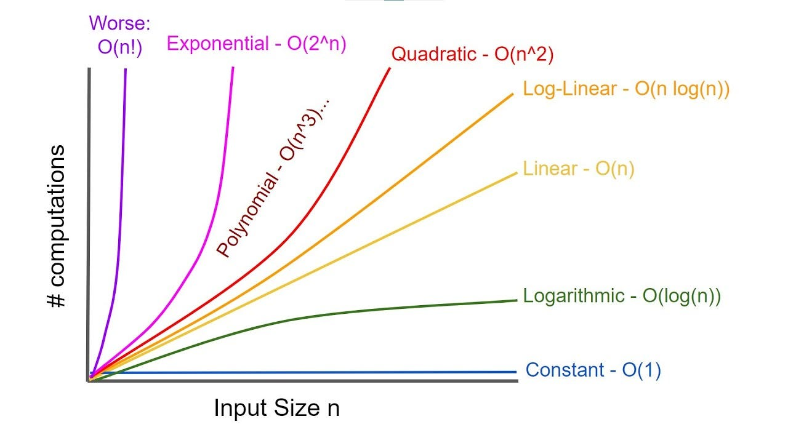
BIG O Graph

Slide 9
Cheat Code To Solve Problem:
[10] => O(n!)
[20] => O(2^n, n^2)
[100] => O(n^4)
[400] => O(n^3)
[2000] => O(log n, n^2)
[10^4] => O(n^2)
[10^6] => O(n log n)
[10^8] => O(n),O(log n)
Brute Force Algorithm -> n^3

Slide 10
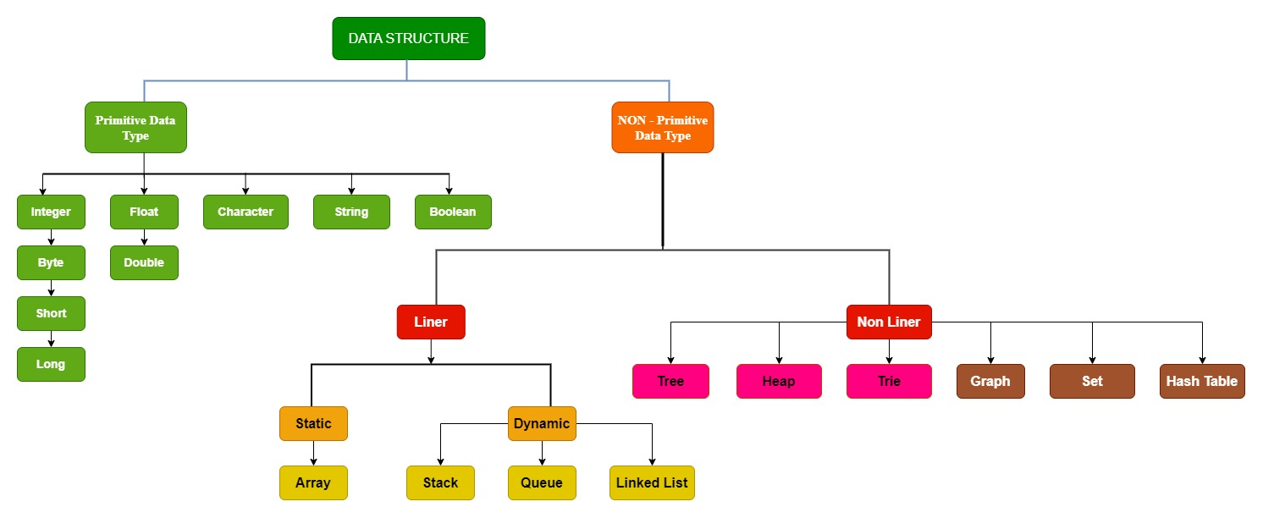
Classification of Data Structure:
1. Primitive Data Structure
2. Non- Primitive Data Structure

Slide 11
Data structures can be classified based on various characteristics, including their organization, relationship among elements, and the nature of their operations. Here are some common classifications of data structures:
Based on Memory Organization:
Primitive Data Structures: These are the basic data types directly supported by programming languages, such as integers, floats, characters, and Booleans.
Non-primitive Data Structures: These structures are derived from primitive data types and include arrays, linked lists, stacks, queues, trees, and graphs.
Based on Relationship Among Elements:
Linear Data Structures: Elements are arranged in a linear or sequential order. Examples include arrays, linked lists, stacks, and queues.
Non-linear Data Structures: Elements have a hierarchical or interconnected relationship. Examples include trees and graphs.
Based on Accessibility of Elements:
Static Data Structures: The size and structure are fixed at compile time. Examples include arrays.
Dynamic Data Structures: Size and structure can be adjusted during runtime. Examples include linked lists, trees, and graphs.

Slide 12
Based on Usage and Operations:
Primitive Data Structures: Basic data types that support simple operations like assignment and arithmetic operations.
Composite Data Structures: Combine primitive data types and provide more complex operations. Examples include arrays and structures in C or classes and lists in high-level programming languages.
Based on Storage Allocation:
Contiguous Data Structures: Elements are stored in adjacent memory locations. Examples include arrays.
Linked Data Structures: Elements are stored in non-contiguous memory locations and connected by pointers. Examples include linked lists, trees, and graphs.
Based on Implementation:
Arrays: A collection of elements stored in contiguous memory locations.
Linked Lists: Elements are connected by pointers, allowing dynamic memory allocation.
Stacks: Follow the Last In, First Out (LIFO) principle.
Queues: Follow the First In, First Out (FIFO) principle.
Trees: Hierarchical structures with a root, branches, and leaves.
Graphs: Non-linear structures with vertices and edges.
Hash Tables: Use a hash function to map keys to their corresponding values in an array.

Slide 13
Abstract Data Types (ADTs):
List ADT: Supports operations like insert, delete, and retrieve.
Stack ADT: Supports operations like push and pop.
Queue ADT: Supports operations like enqueue and dequeue.
Tree ADT: Represents hierarchical relationships.
Graph ADT: Represents interconnected relationships.
Hash Table ADT: Supports key-value pair storage with fast access.

Slide 14
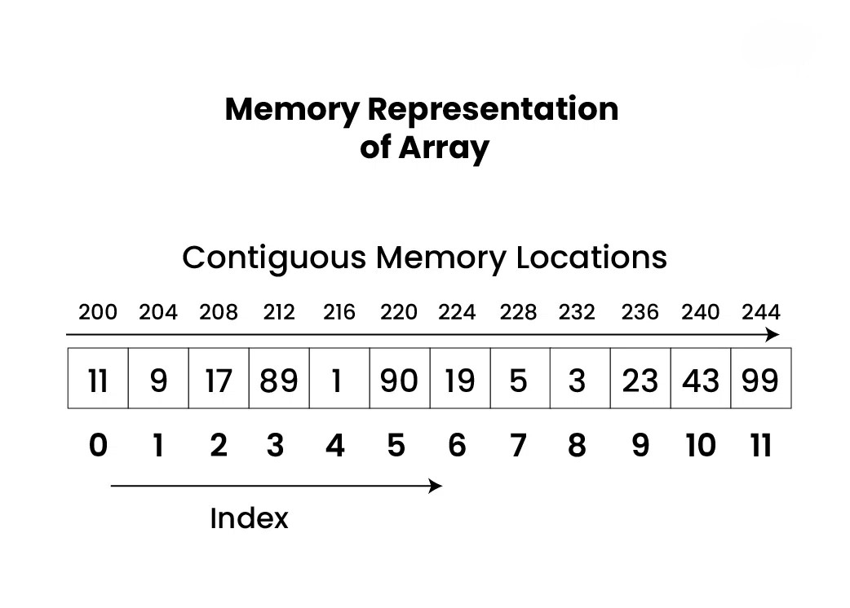
Introduction To Array :
Array is a linear data structure where all elements are arranged sequentially. It is a collection of elements of same data type stored at contiguous memory locations. It is a static data structure with a fixed size.
Array Operations
------------------------------
Common operations performed on arrays.
Traversal
Insertion
Deletion
Searching
Jagged Array in Java
---------------------------------
A jagged array is an array of arrays such that member arrays can be of different sizes, i.e., we can create a 2-D array but with a variable number of columns in each row. These types of arrays are also known as Jagged arrays.

Slide 15
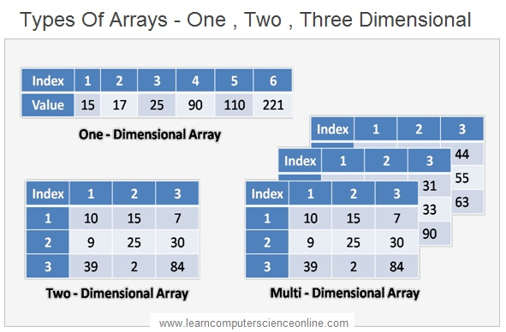
Types of Array
---------------------------
There are two main types of arrays:
One-dimensional arrays: These arrays store a single row of elements.
Multidimensional arrays: These arrays store multiple rows of elements.
Advantages Of Jagged arrays :
Dynamic allocation: Jagged arrays allow you to allocate memory dynamically, meaning that you can specify the size of each sub-array at runtime, rather than at compile-time.
Space utilization: Jagged arrays can save memory when the size of each sub-array is not equal. In a rectangular array, all sub-arrays must have the same size, even if some of them have unused elements. With a jagged array, you can allocate just the amount of memory that you need for each sub-array.
Flexibility: Jagged arrays can be useful when you need to store arrays of different lengths or when the number of elements in each sub-array is not known in advance.
Improved performance: Jagged arrays can be faster than rectangular arrays for certain operations, such as accessing elements or iterating over sub-arrays, because the memory layout is more compact.

Slide 16
Basic Problem In Arrays:
1. Array Declaration
2. Insertion in Array
3. Deletion in Array
4. Row Base implementation
5. Column Base implementation

Slide 17
Introduction to LinkedList:
Linked List is a linear data structure, in which elements are not stored at a contiguous location, rather they are linked using pointers. Linked List forms a series of connected nodes, where each node stores the data and the address of the next node.
Node Structure: A node in a linked list typically consists of two components:
Data: It holds the actual value or data associated with the node.
Next Pointer: It stores the memory address (reference) of the next node in the sequence.
Head and Tail: The linked list is accessed through the head node, which points to the first node in the list. The last node in the list points to NULL, indicating the end of the list. This node is known as the tail node.
Advantage of Linked List:
Dynamic Data structure: The size of memory can be allocated or de-allocated at run time based on the operation insertion or deletion.
Ease of Insertion/Deletion: The insertion and deletion of elements are simpler than arrays since no elements need to be shifted after insertion and deletion, Just the address needed to be updated.
Efficient Memory Utilization: As we know Linked List is a dynamic data structure the size increases or decreases as per the requirement, so this avoids the wastage of memory.
Implementation: Various advanced data structures can be implemented using a linked list like a stack, queue, graph, hash maps, etc.

Slide 18
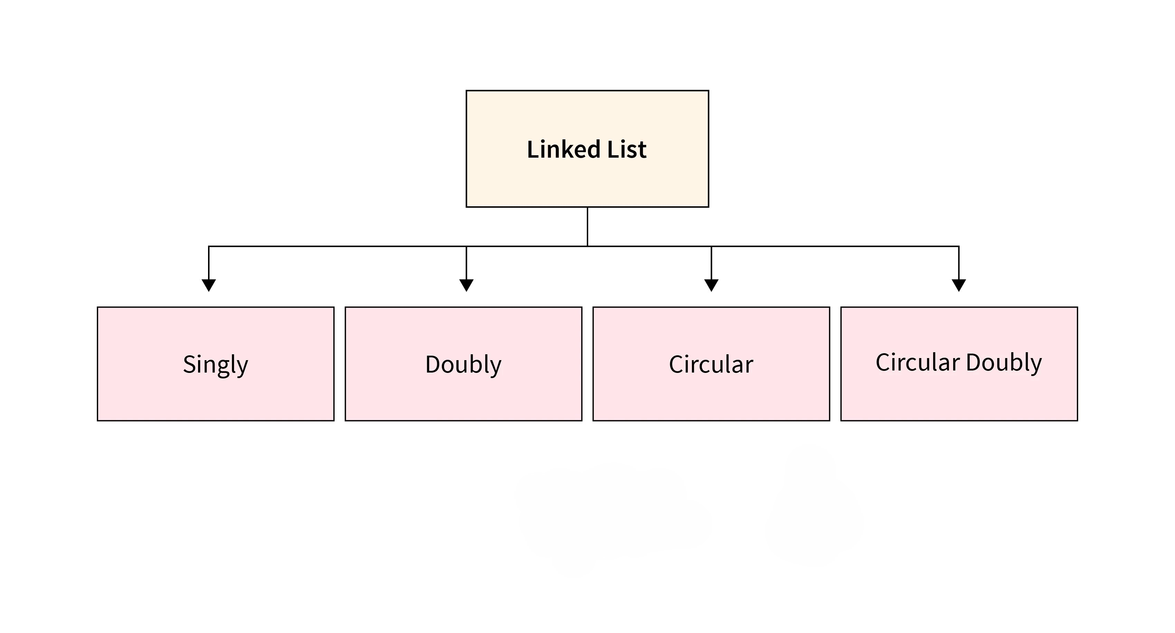
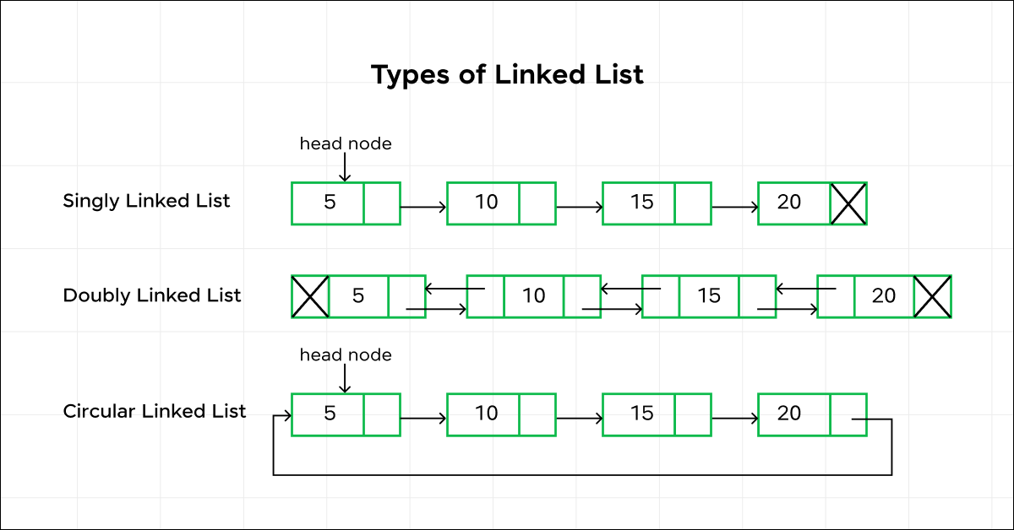
Disadvantage of Linked List:
Random Access: Unlike arrays, linked lists do not allow direct access to elements by index. Traversal is required to reach a specific node.
Extra Memory: Linked lists require additional memory for storing the pointers, compared to arrays.
Types Of Linked List

Slide 19
Single Linked List:
A singly linked list is a special type of linked list in which each node has only one link that points to the next node in the linked list.
Backward traversing not possible: In singly linked list does not support backward traversing.
Application of Singly Linked Lists:
Memory management: Singly linked lists can be used to implement memory pools, in which memory is allocated and deallocated as needed.
Database indexing: Singly linked lists can be used to implement linked lists in databases, allowing for fast insertion and deletion operations.
Representing polynomials and sparse matrices: Singly linked lists can be used to efficiently represent polynomials and sparse matrices, where most elements are zero.
Operating systems: Singly linked lists are used in operating systems for tasks such as scheduling processes and managing system resources.
Double Linked List:
A doubly linked list is a special type of linked list in which each node contains a pointer to the previous node as well as the next node in the structure.
Two-way navigation: In a doubly linked list, each node contains pointers to both the previous and next elements, allowing for navigation in both forward and backward directions.

Slide 20
Application of Doubly Linked List:
Implementing a Hash Table: Doubly linked lists can be used to implement hash tables, which are used to store and retrieve data efficiently based on a key.
Dynamic Memory Allocation: In systems programming, doubly linked lists can be used to manage dynamic memory allocation, where memory blocks are allocated and deallocated as needed.
Reversing a List: A doubly linked list can be used to reverse a list efficiently by swapping the previous and next pointers of each node.
Introduction to Circular Linked List
The circular linked list is a linked list where all nodes are connected to form a circle. In a circular linked list, the first node and the last node are connected to each other which forms a circle. There is no NULL at the end.
Applications of circular linked lists:
Multiplayer games use this to give each player a chance to play.
A circular linked list can be used to organize multiple running applications on an operating system. These applications are iterated over by the OS.
Circular linked lists can be used in resource allocation problems.
Circular linked lists are commonly used to implement circular buffers,
Circular linked lists can be used in simulation and gaming.

Slide 21
There are generally two types of circular linked lists:
Circular singly linked list: In a circular Singly linked list, the last node of the list contains a pointer to the first node of the list. We traverse the circular singly linked list until we reach the same node where we started. The circular singly linked list has no beginning or end. No null value is present in the next part of any of the nodes.
Circular Doubly linked list: Circular Doubly Linked List has properties of both doubly linked list and circular linked list in which two consecutive elements are linked or connected by the previous and next pointer and the last node points to the first node by the next pointer and also the first node points to the last node by the previous pointer.
Basic Operation on Linked List
1. Insertion in the linked list:
Insertion at the beginning of the list
Insertion at the end of the list
Insertion in between the nodes
2. Deletion in the linked list:
Deletion at the beginning of the list
Deletion at the end of the list
Deletion in between the nodes

Slide 22
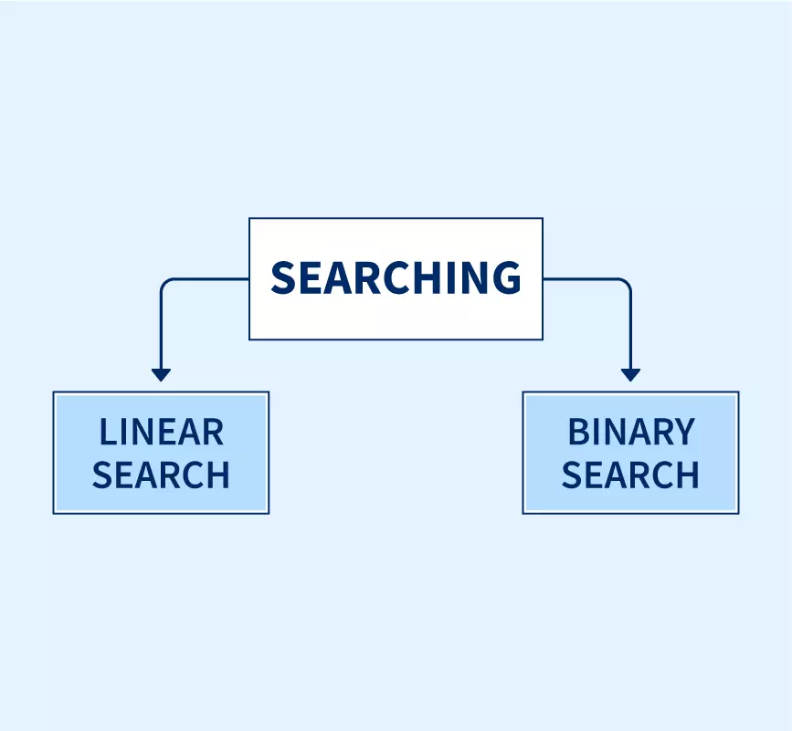
Introduction to Searching Algorithms:
Types Of Search Algorithms
Linear Search
Binary Search
Linear Search:
The linear search algorithm is defined as a sequential search algorithm that starts at one end and goes through each element of a list until the desired element is found; otherwise, the search continues till the end of the dataset.
Time Complexity:
Best Case: In the best case, the key might be present at the first index. So, the best-case complexity is O(1)
Worst Case: In the worst case, the key might be present at the last index i.e., opposite to the end from which the search has started in the list. So, the worst-case complexity is O(N) where N is the size of the list.
Average Case: O(N/2)
Space Complexity:
Auxiliary Space: O(1) as except for the variable to iterate through the list, no other variable is used.

Slide 23
Applications of Linear Search Algorithm:
Unsorted Lists: When we have an unsorted array or list, linear search is most commonly used to find any element in the collection.
Small Data Sets: Linear Search is preferred over binary search when we have small data sets with
Searching Linked Lists: In linked list implementations, linear search is commonly used to find elements within the list. Each node is checked sequentially until the desired element is found.
Disadvantages of Linear Search Algorithm:
Linear search has a time complexity of O(N), which in turn makes it slow for large datasets.
Not suitable for large arrays.

Slide 24
Binary Search:
Binary Search Algorithm is used in a sorted array by repeatedly dividing the search interval in half. The idea of binary search is to use the information that the array is sorted and reduce the time complexity to
O(log N).
Conditions to apply Binary Search Algorithm in a Data Structure:
The data structure must be sorted.
Access to any element of the data structure should take constant time.
Time Complexity:
Best Case: O(1)
Average Case: O(log N)
Worst Case: O(log N)
Advantages of Binary Search:
Binary search is faster than linear search, especially for large arrays.
More efficient than other searching algorithms with a similar time complexity, such as interpolation search or exponential search.
Binary search is well-suited for searching large datasets that are stored in external memory, such as on a hard drive or in the cloud.

Slide 25
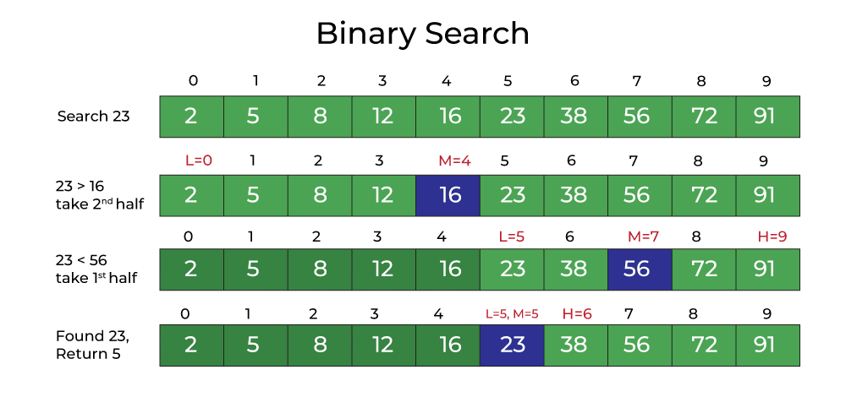
Disadvantages of Binary Search:
The array should be sorted.
Binary search requires that the data structure being searched be stored in contiguous memory locations.
Binary search requires that the elements of the array be comparable, meaning that they must be able to be ordered.
The Binary Search Algorithm can be implemented in the following two ways:
Iterative Binary Search Algorithm
Recursive Binary Search Algorithm

Slide 26
Introduction to Sorting Techniques:
Sorting refers to rearrangement of a given array or list of elements according to a comparison operator on the elements. The comparison operator is used to decide the new order of elements in the respective data structure.
When we have a large amount of data, it can be difficult to deal with it, especially when it is arranged randomly. When this happens, sorting that data becomes crucial. It is necessary to sort data in order to make searching easier.
Types of Sorting Techniques:
There are various sorting algorithms are used in data structures. The following two types of sorting algorithms can be broadly classified:
Comparison-based: We compare the elements in a comparison-based sorting algorithm)
Non-comparison-based: We do not compare the elements in a non-comparison-based sorting algorithm)

Slide 27
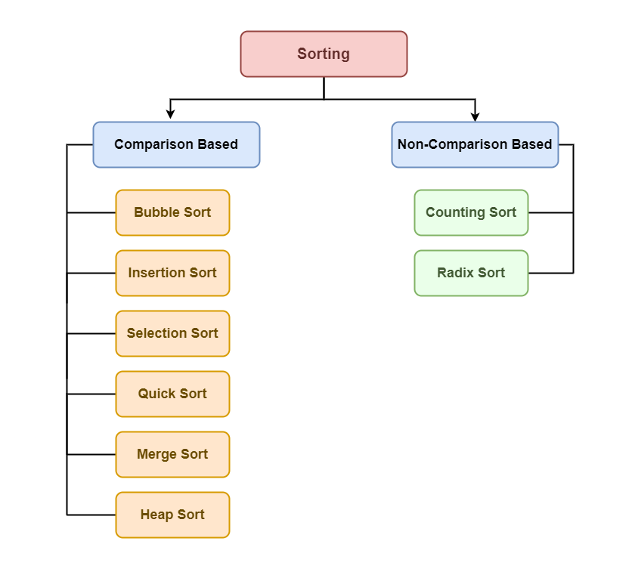
Types of Sorting Techniques:

Slide 28
Bubble Sort:
Bubble Sort is the simplest sorting algorithm that works by repeatedly swapping the adjacent elements if they are in the wrong order. This algorithm is not suitable for large data sets as its average and worst-case time complexity is quite high.
Bubble Sort Algorithm:
In Bubble Sort algorithm, traverse from left and compare adjacent elements and the higher one is placed at right side.
In this way, the largest element is moved to the rightmost end at first.
This process is then continued to find the second largest and place it and so on until the data is sorted.
Advantages of Bubble Sort:
Bubble sort is easy to understand and implement.
It does not require any additional memory space.
It is a stable sorting algorithm, meaning that elements with the same key value maintain their relative order in the sorted output.

Slide 29
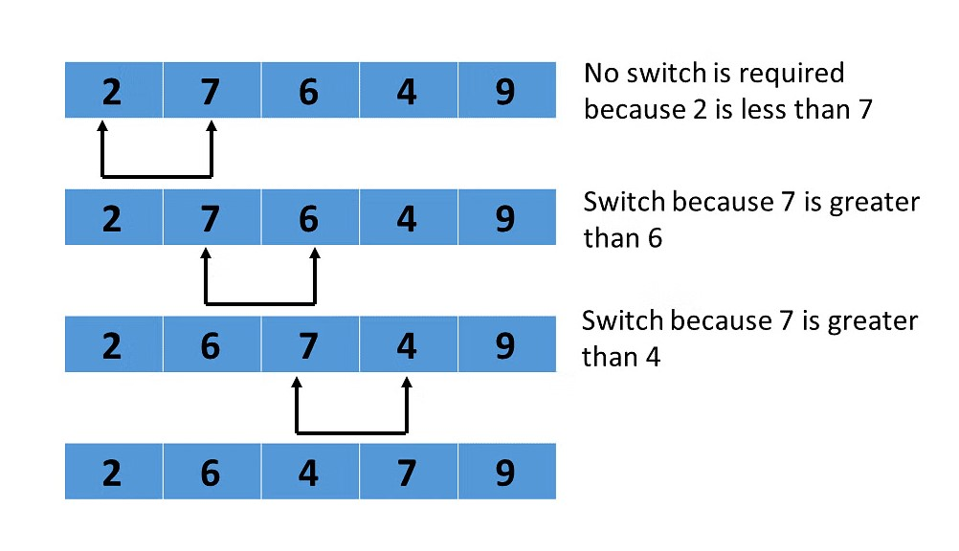
Disadvantages of Bubble Sort:
Bubble sort has a time complexity of O(N2) which makes it very slow for large data sets.
Bubble sort is a comparison-based sorting algorithm, which means that it requires a comparison operator to determine the relative order of elements in the input data set. It can limit the efficiency of the algorithm in certain cases.
Complexity Analysis of Bubble Sort:
Time Complexity: O(N^2)
Auxiliary Space: O(1)

Slide 30
Selection Sort Algorithm:
Selection sort is a simple and efficient sorting algorithm that works by repeatedly selecting the smallest (or largest) element from the unsorted portion of the list and moving it to the sorted portion of the list.
Time Complexity: The time complexity of Selection Sort is O(N2) as there are two nested loops:
One loop to select an element of Array one by one = O(N)
Another loop to compare that element with every other Array element = O(N)
Therefore, overall complexity = O(N) * O(N) = O(N*N) = O(N2)
Advantages of Selection Sort Algorithm
Simple and easy to understand.
Works well with small datasets.
Disadvantages of the Selection Sort Algorithm
Selection sort has a time complexity of O(n^2) in the worst and average case.
Does not work well on large datasets.
Does not preserve the relative order of items with equal keys which means it is not stable.

Slide 31
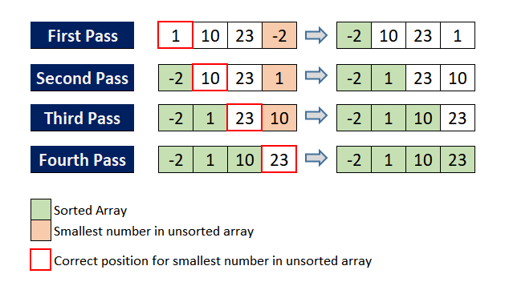
Applications of Selection Sort Algorithm
Mainly works as a basis for some more efficient algorithms like Heap Sort. Heap Sort mainly uses Heap Data Structure along with the Selection Sort idea.
Used when memory writes (or swaps) are costly for example EEPROM or Flash Memory. When compared to other popular sorting algorithms, it takes relatively less memory writes (or less swaps) for sorting. But Selection sort is not optimal in terms of memory writes, cycle sort even requires lesser memory writes than selection sort.
Simple technique and used to introduce sorting in teaching.
Used as a benchmark for comparison with other algorithms.

Slide 32
Insertion Sort Algorithm:
Insertion sort is a simple sorting algorithm that works by iteratively inserting each element of an unsorted list into its correct position in a sorted portion of the list. It is a stable sorting algorithm, meaning that elements with equal values maintain their relative order in the sorted output.
To achieve insertion sort, follow these steps:
We start with second element of the array as first element in the array is assumed to be sorted.
Compare second element with the first element and check if the second element is smaller then swap them.
Move to the third element and compare it with the second element, then the first element and swap as necessary to put it in the correct position among the first three elements.
Continue this process, comparing each element with the ones before it and swapping as needed to place it in the correct position among the sorted elements.
Repeat until the entire array is sorted.
Time Complexity of Insertion Sort:
Best case: O(n) , If the list is already sorted, where n is the number of elements in the list.
Average case: O(n ² ) , If the list is randomly ordered
Worst case: O(n ² ) , If the list is in reverse order

Slide 33
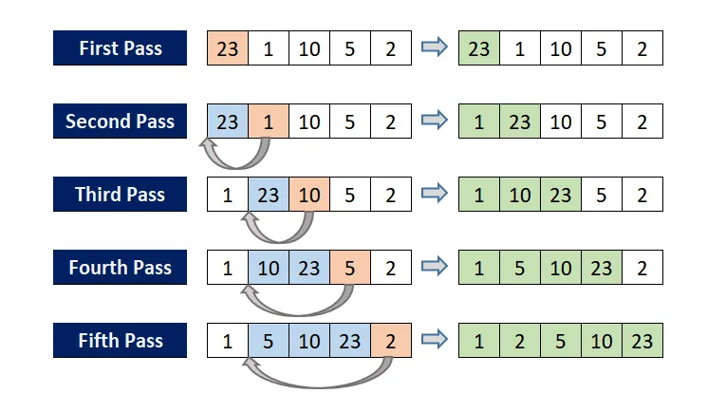
Advantages of Insertion Sort:
Simple and easy to implement.
Stable sorting algorithm.
Efficient for small lists and nearly sorted lists.
Disadvantages of Insertion Sort:
Inefficient for large lists.
Not as efficient as other sorting algorithms (e.g., merge sort, quick sort) for most cases.

Slide 34
Merge Sort Algorithm:
In simple terms, we can say that the process of merge sort is to divide the array into two halves, sort each half, and then merge the sorted halves back together. This process is repeated until the entire array is sorted.
Time Complexity:
Best Case: O(n log n), When the array is already sorted or nearly sorted.
Average Case: O(n log n), When the array is randomly ordered.
Worst Case: O(n log n), When the array is sorted in reverse order.
Advantages of Merge Sort:
Stability : Merge sort is a stable sorting algorithm, which means it maintains the relative order of equal elements in the input array.
Guaranteed worst-case performance: Merge sort has a worst-case time complexity of O(N logN) , which means it performs well even on large datasets.
Simple to implement: The divide-and-conquer approach is straightforward.
Naturally Parallel : We independently merge subarrays that makes it suitable for parallel processing.

Slide 35
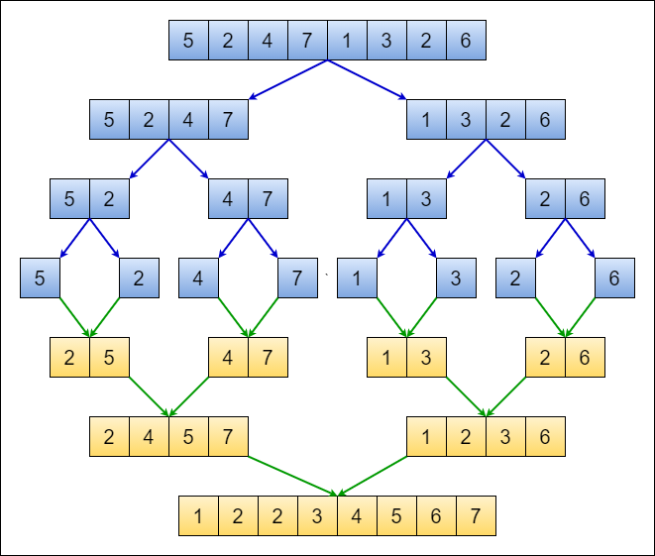
Disadvantages of Merge Sort:
Space complexity: Merge sort requires additional memory to store the merged sub-arrays during the sorting process.
Slower than Quicksort in general. Quicksort is more cache friendly because it works in-place.

Slide 36
Quick Sort Algorithm:
Quicksort algorithm is based on the divide and conquer approach where an array is divided into subarrays by selecting a pivot element.
While dividing the array, the pivot element should be positioned in such a way that elements less than pivot are kept on the left side and elements greater than pivot are on the right side.
Time Complexity:
Best Case : Ω (N log (N))
Average Case: θ ( N log (N))
Worst Case: O(N ^ 2)
Advantages of Quick Sort:
It is a divide-and-conquer algorithm that makes it easier to solve problems.
It is efficient on large data sets.
It has a low overhead, as it only requires a small amount of memory to function.
It is Cache Friendly as we work on the same array to sort and do not copy data to any auxiliary array.
Disadvantages of Quick Sort:
It has a worst-case time complexity of O(N 2 ), which occurs when the pivot is chosen poorly.
It is not a good choice for small data sets.

Slide 37
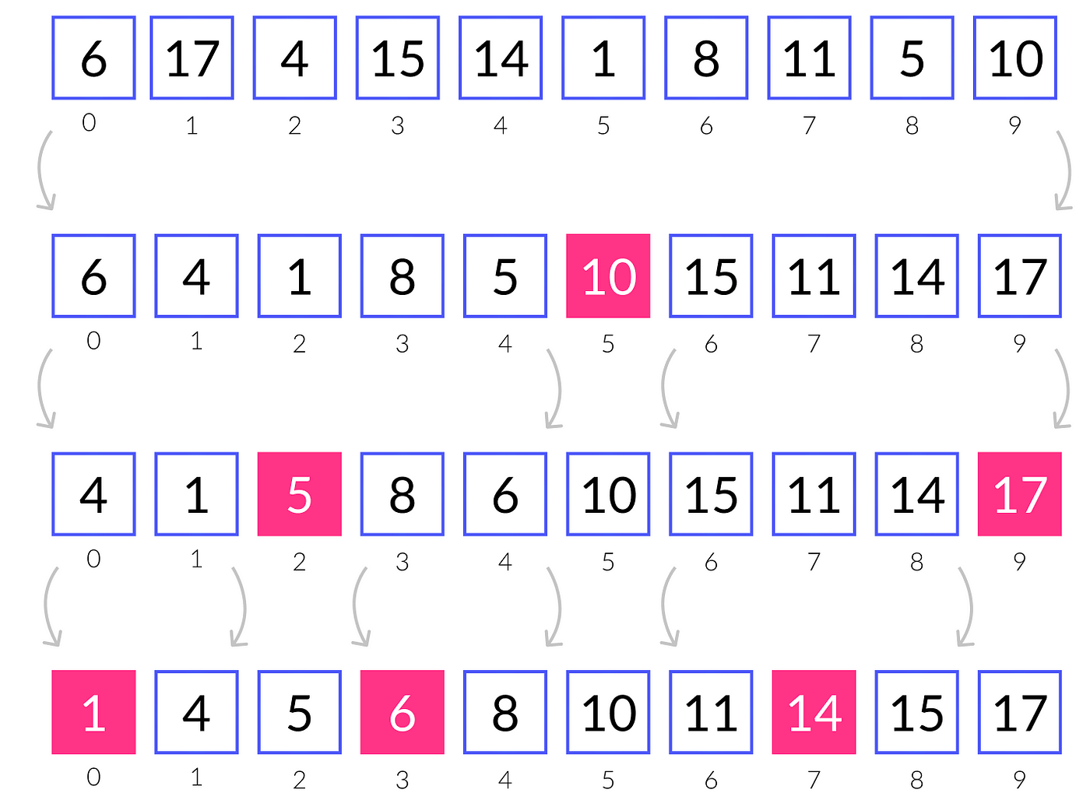
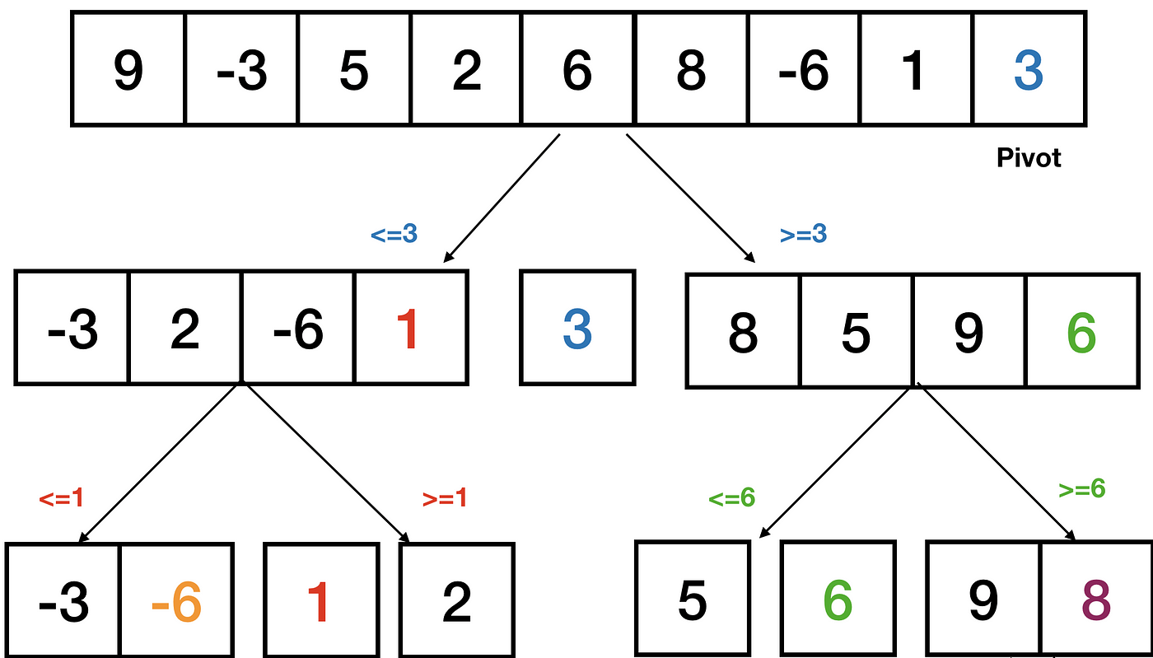
Quick Sort Algorithm:

Slide 38
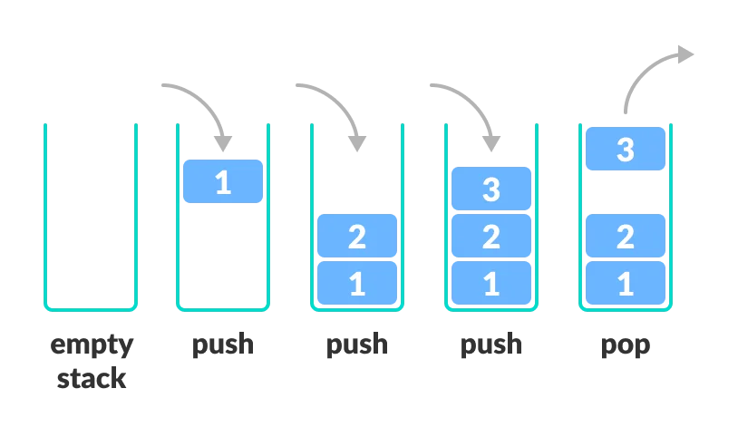
Stack Data Structure:
Stack Data Structure is a linear data structure that follows LIFO (Last In First Out) Principle , so the last element inserted is the first to be popped out. in which the insertion of a new element and removal of an existing element takes place at the same end represented as the top of the stack.
To implement the stack, it is required to maintain the pointer to the top of the stack , which is the last element to be inserted because we can access the elements only on the top of the stack.

Slide 39
Types of Stack Data Structure:
Fixed Size Stack : As the name suggests, a fixed size stack has a fixed size and cannot grow or shrink dynamically. If the stack is full and an attempt is made to add an element to it, an overflow error occurs. If the stack is empty and an attempt is made to remove an element from it, an underflow error occurs.
Dynamic Size Stack : A dynamic size stack can grow or shrink dynamically. When the stack is full, it automatically increases its size to accommodate the new element, and when the stack is empty, it decreases its size. This type of stack is implemented using a linked list, as it allows for easy resizing of the stack.
Basic Operations on Stack Data Structure:
push() to insert an element into the stack
pop() to remove an element from the stack
top() Returns the top element of the stack.
isEmpty() returns true if stack is empty else false.
isFull() returns true if the stack is full else false.

Slide 40
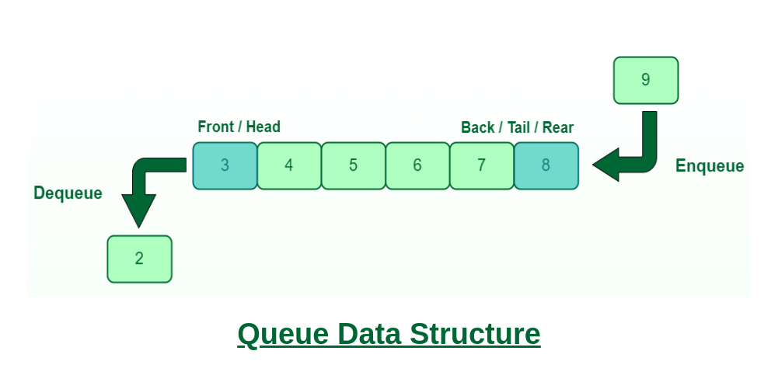
Queue Data Structure:
Queue Data Structure is a linear data structure that follows FIFO (First In First Out) Principle, so the first element inserted is the first to be popped out.
A Queue is like a line waiting to purchase tickets, where the first person in line is the first person served. (i.e. First Come First Serve).
Position of the entry in a queue ready to be served, that is, the first entry that will be removed from the queue, is called the front of the queue(sometimes, head of the queue). Similarly, the position of the last entry in the queue, that is, the one most recently added, is called the rear (or the tail) of the queue.

Slide 41
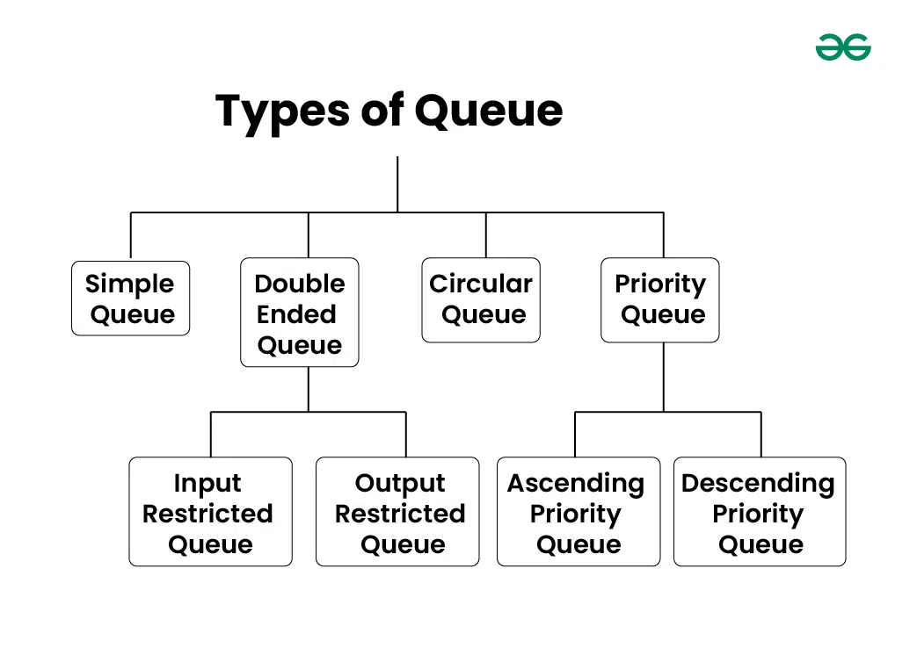
Basic Operations of Queue Data Structure:
Enqueue (Insert): Adds an element to the rear of the queue.
Dequeue (Delete): Removes and returns the element from the front of the queue.
Peek: Returns the element at the front of the queue without removing it.
Empty: Checks if the queue is empty.
Full: Checks if the queue is full

Slide 42
Applications of Queue:
Task scheduling in operating systems
Data transfer in network communication
Simulation of real-world systems (e.g., waiting lines)
Priority queues for event processing queues for event processing
Type Of Implementation Of Queue:
Array Implementation of Queue:
Simple Queue
1.1 -> Moving all element to left during dequeue.
1.2 -> Move front index by one.
Circular Queue

Slide 43
Introduction To Bitwise Operators:
Bitwise OR (|) :
This operator is a binary operator, denoted by ‘|’. It returns bit by bit OR of input values, if either of the bits is 1, it gives 1, else it shows 0.
Bitwise AND (&) :
This operator is a binary operator, denoted by ‘&.’ It returns bit by bit AND of input values, if both bits are 1, it gives 1, else it shows 0.
Bitwise XOR (^) :
This operator is a binary operator, denoted by ‘^.’ It returns bit by bit XOR of input values, if corresponding bits are different, it gives 1, else it shows 0.
Bitwise Complement (~):
This operator is a unary operator, denoted by ‘~.’ It returns the one’s complement representation of the input value, with all bits inverted, which means it makes every 0 to 1, and every 1 to 0.
Left Shift Operator:
The left shift operator shifts all bits towards the left by a certain number of specified bits. It is denoted by <<.
General Formula → a << b ➔ (a * 2^b )
if a = 5 , a << 3 ➔ (5* 2^3) → 40

Slide 44
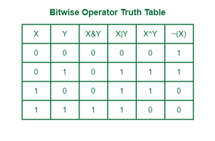
Right Shift Operator The right shift operator shifts all bits towards the right by a certain number of specified bits. It is denoted by >>.
General Formula → a >> b ➔ (a / 2^b )
if a = 4 , a << 3 ➔ (40 / 2^3) → 5

Slide 45
Number Systems:
Types Of Number System:
Binary number system
Octal number system
Decimal number system
Hexadecimal number system
Binary number system → It has only two digits '0' and '1' so its base is 2.
Octal number system → It has eight digits (0, 1, 2, 3, 4, 5, 6, 7) so its base is 8.
Decimal number system → This number system has ten digits (0, 1, 2, 3, 4, 5, 6, 7, 8, 9) so its base is 10.
Hexadecimal number system → This number system has 16 digits that ranges from 0 to 9 and A to F. So, its base is 16. (0, 1, 2, 3, 4, 5, 6, 7, 8, 9 , A, B, C, D, E, F) .

Slide 46
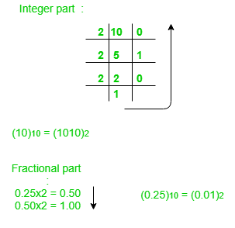
Convert One Number Systems To Other:
Step 1 −> Divide the decimal number to be converted by the value of the new base.
Step 2 −> Get the remainder from Step 1 as the rightmost digit (least significant digit) of new base number.
Step 3 −> Divide the quotient of the previous divide by the new base.
Step 4 −> Record the remainder from Step 3 as the next digit (to the left) of the new base number.
Decimal To Binary → (152)₁₀=(10011000)_{2 ,} (0.25)₁₀=(.01)₂
Binary To Decimal:
(1010.01)2
1x23 + 0x22 + 1x21+ 0x20 + 0x2 -1 + 1x2 -2 = 8+0+2+0+0+0.25 = 10.25
(1010.01)2 = (10.25)10
Operation | Result | carry
0.25×2 | 0.50 | 0
0.50×2 | 0 | 1

Slide 47
Important Problem :
Find the i bit
Set the i bit

Slide 48
String Data Type :
Strings are the type of objects that can store the character of values and in Java, every character is stored in 16 bits. Using UTF 16-bit encoding. A string acts the same as an array of characters in Java.
There are two ways to create a string in Java:
String Literal → To make Java more memory efficient (because no new objects are created if it exists already in the string constant pool).
Using new Keyword → Java creates a new String object in heap memory, even if the string already exists in the string pool. This means two objects could hold the same string, one in the pool and one in the heap.
Key Points:
== compares object references (memory locations), so s1 == s2 is false.
.equals() compares the actual content of the strings, so s1.equals(s2) is true.
Why string objects are immutable in Java?
Because java uses the concept of string literal. Suppose there are 5 reference variables, all refer to one object “Sachin”. If one reference variable changes the value of the object, it will be affected by all the reference variables. That is why string objects are immutable in Java.

Slide 49
Pattern Problem:
*
**
***
****
*****
Steps Breakdown:
Step 1: Define the number of rows (n in this case).
Step 2: The outer for loop runs from 1 to n, controlling the number of rows.
Step 3: The inner for loop runs from 1 to i(the current row number), printing * for that row.
Step 4: After the inner loop finishes, a System.out.println() moves the cursor to the next line.

Slide 50
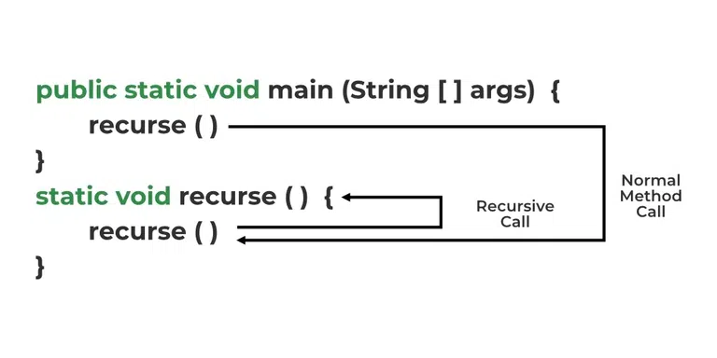
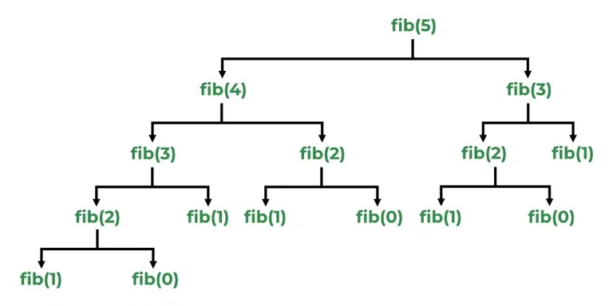
Recursion :
In Java, Recursion is a process in which a function calls itself directly or indirectly is called recursion and the corresponding function is called a recursive function.
Working of Recursion:
The idea is to represent a problem in terms of one or more smaller sub-problems and add base conditions that stop the recursion. For example, we compute factorial n if we know the factorial of (n-1). The base case for factorial would be n = 0. We return 1 when n = 0.

Slide 51
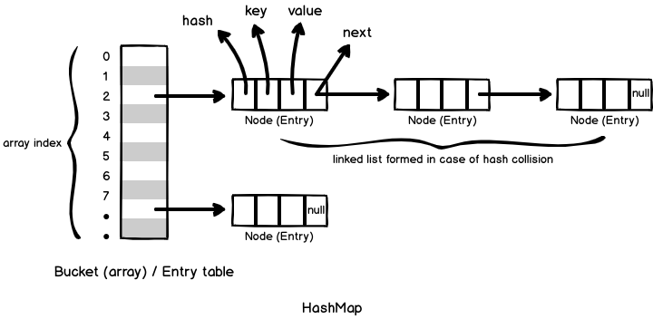
Introduction to Hashing
Hashing refers to the process of generating a fixed-size output from an input of variable size using the mathematical formulas known as hash functions. This technique determines an index or location for the storage of an item in a data structure.
What is Collision?
Collision in Hashing occurs when two different keys map to the same hash value. Hash collisions can be intentionally created for many hash algorithms. The probability of a hash collision depends on the size of the algorithm, the distribution of hash values and the efficiency of Hash function.

Slide 52
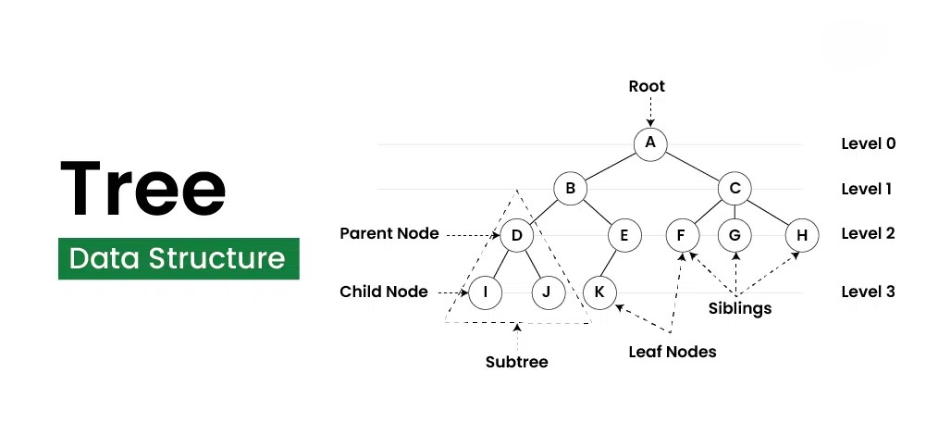
Tree Data Structure:
A tree data structure is a hierarchical structure that is used to represent and organize data in a way that is easy to navigate and search. It is a collection of nodes that are connected by edges and has a hierarchical relationship between the nodes.
The topmost node of the tree is called the root, and the nodes below it are called the child nodes. Each node can have multiple child nodes, and these child nodes can also have their own child nodes, forming a recursive structure.

Slide 53
Terminologies In Tree Data Structure:
Parent Node: The node which is a predecessor of a node is called the parent node of that node. {B} is the parent node of {D, E}.
Child Node: The node which is the immediate successor of a node is called the child node of that node. Examples: {D, E} are the child nodes of {B}.
Root Node: The topmost node of a tree or the node which does not have any parent node is called the root node. {A} is the root node of the tree. A non-empty tree must contain exactly one root node and exactly one path from the root to all other nodes of the tree.
Leaf Node or External Node: The nodes which do not have any child nodes are called leaf nodes. {I, J, K, F, G, H} are the leaf nodes of the tree.
Ancestor of a Node: Any predecessor nodes on the path of the root to that node are called Ancestors of that node. {A,B} are the ancestor nodes of the node {E}
Descendant: A node x is a descendant of another node y if and only if y is an ancestor of x.
Sibling: Children of the same parent node are called siblings. {D,E} are called siblings.
Level of a node: The count of edges on the path from the root node to that node. The root node has level 0.
Internal node: A node with at least one child is called Internal Node.
Neighbor of a Node: Parent or child nodes of that node are called neighbors of that node.
Subtree: Any node of the tree along with its descendant.

Slide 54
Types of Traversals
To process nodes in a binary tree, three main types of depth-first traversal are commonly used:
Inorder Traversal (Left, Root, Right): LRR
Visits the left subtree, the root node, and then the right subtree.
For binary search trees, this results in nodes being visited in ascending order.
Preorder Traversal (Root, Left, Right): RLR
Visits the root node first, followed by the left subtree and the right subtree.
Often used to copy trees or create a prefix expression of an expression tree.
Postorder Traversal (Left, Right, Root): LRR
Visits the left subtree, the right subtree, and then the root node.
Useful for deleting or freeing nodes after processing children.
Example
1
/ \
2 3
/ \
4 5
The traversal outputs would be:
Inorder: 4 2 5 1 3
Preorder: 1 2 4 5 3
Postorder: 4 5 2 3 1

